Slide 1
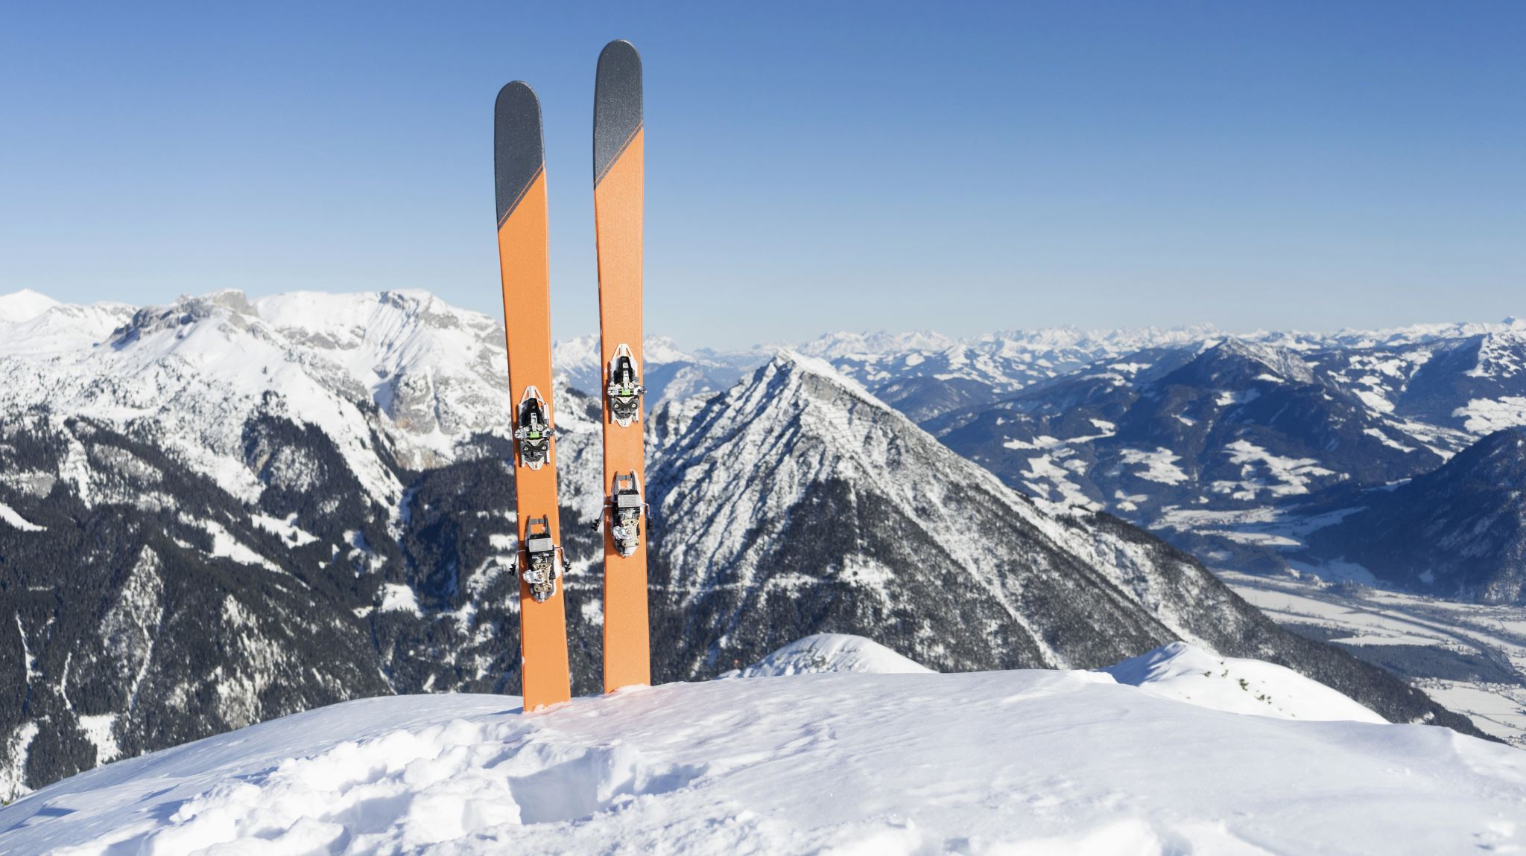
Big Mountain Ski Resort
Data analysis and recommendations

Slide 2
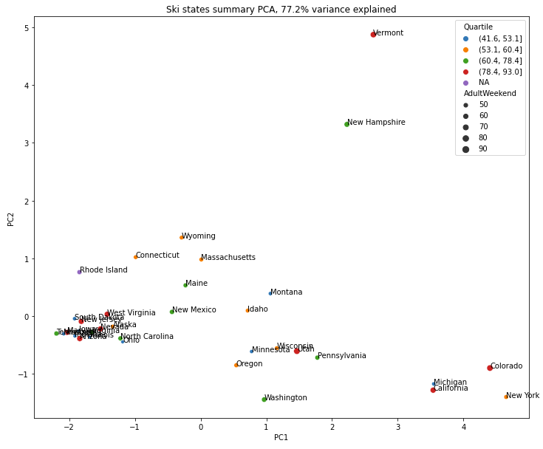
Problem Identification
Clean and wrangle data
Review distribution of features
Imported state population and summary data
Added state total feature summary and resort density data
Scaled and transformed data using principal components analysis (PCA)

Slide 3
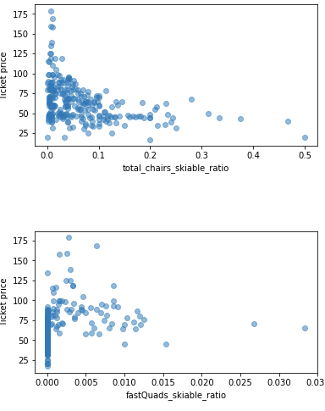
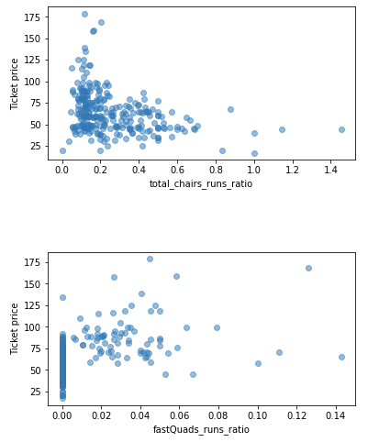
Problem Identification
Looked for strongest feature correlations to ticket price
Vertical Drop
Fast Quads
Total runs
Total Chairs
Plotted total chairs and fast quads ratios
No fast quads = low ticket price
High total chairs and fast quads relative to skiable area and total runs = low ticket price

Slide 4
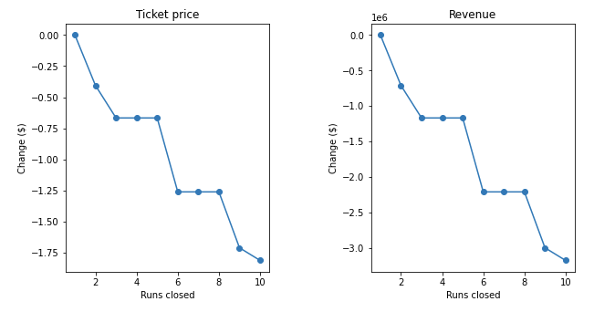
Recommendation & Key Findings
Model prediction for Big Mountain Ski Ticket value: $95.87
Decreasing number of runs by up to 5 predicts relatively low loss of ticket price value
Adding a run, increasing vertical drop by 150 feet and adding an additional chair lift show increase of predicted ticket price support by $8.61 and annual revenue of $15,065,471

Slide 5
Modeling Results and Analysis
Linear Regression Model
Defined and fit pipeline
Imputed missing feature data using prediction, scaled and trained data all using sklearn’s fit() method
Used cross validation to partition train data set into k number of folds and determine optimal number
Mean Absolute Error (MAE): $11.79

Slide 6
Modeling Results and Analysis
Random Forest Regression
Defined and fit pipeline
Fit and assessed performance using cross-validation
Hyperparameter search using GridSearchCV
MAE: $9.54

Slide 7
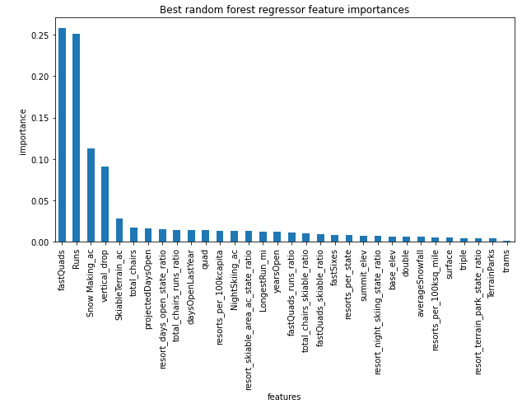
Modeling Results and Analysis
Top four features shared by both models:
fastQuads
Runs
Snow Making_ac
vertical_drop

Slide 8
Summary and Conclusion
Modeled using linear and random forest regression models
Trained models on 70/30 Train/Test split of data set
Determined Random Forest model to be superior model
Running shortlisted scenarios proposed found two to improve potential revenue:
Closing up to 5 runs
Increasing vertical drop by 150 ft and installing additional lift

